Slide 1
Engaging the Cap Sooner Rethinking Your Current Algorithm
Saihari Sadanandan, MD,FACC, FSCAI
Director, Interventional Cardiology and Cardiac Catheterization Labs
St. Joseph’s Hospital
Bay Care Health System
Tampa, Florida

Slide 2
Disclosures
Invited Speaker – Maquet / Getinge

Slide 3
Not all CTO’s are the same….

Slide 4
Proximal and Distal caps organize and are frequently fibrocalcific and are difficult to penetrate.
Mustapha JA et al

Slide 5
But morphology changes along the course of the CTO….

Slide 6
Both proximal and distal caps organize in different morphologies

Slide 7
CTOP classification – Proposed Strategies for access and approach
Mustapha JA et al

Slide 8
C-TOP classification and recommended approaches – Antegrade or retrograde or both
Mustapha JA et al

Slide 9
It is predicated on the fact that a concave fibro-calcific cap is difficult to penetrate and the wire or device is deflected away
Mustapha JA et al

Slide 10
Wingman Device

Slide 11
Hollow bore needle like tip that plunges forward and rotates

Slide 12
Different sizes, 0.0014, 0.0018 and 0.0035

Slide 13
Can go through various sheaths – Spex shapable tip sheath

Slide 14
Synergistic Duo

Slide 15
Case 1 – SFA CTO approached with 0.0035 wingman device
79 year old male with
HTN, DM and Hyperlipidemia
Rutherford III claudication
ABI 0.6

Slide 16
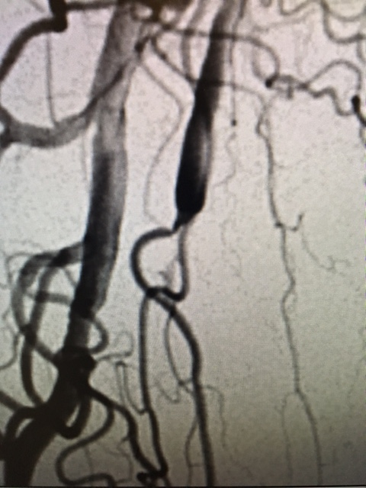
Proximal SFA occlusion – what appeared to be a tapered cap…. tapered not into to lumen but into a collateral….

Slide 17
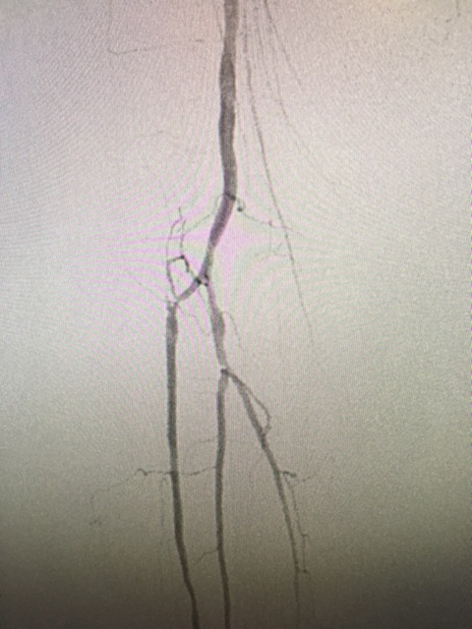
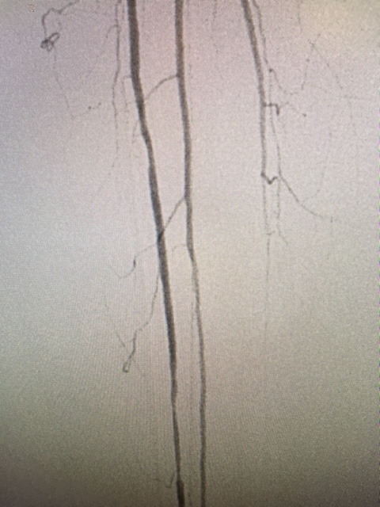
Long CTO with calcified flat distal cap and diseased 2 vessel runoff – Retrograde pedal access feasible

Slide 18
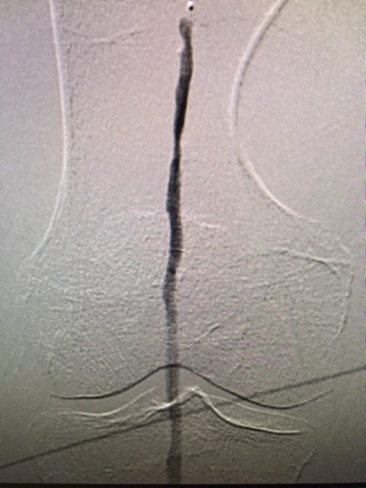
Unsupported 0.0035 Wingman device with angled stiff glidewire and successful crossing…
Needle needed to be plunged
and rotated at the proximal Cap,
mid CTO and distal Cap as
device met resistance

Slide 19
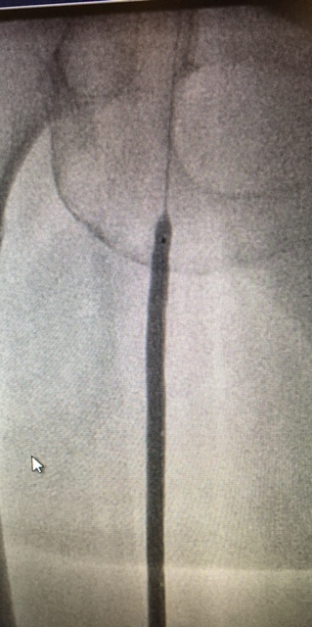
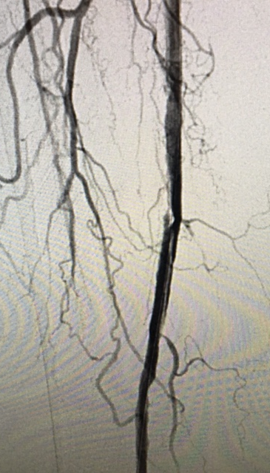
PTA demonstrated a waist at the site of resistance mid CTO suggesting severe calcification at that location – Suboptimal results with PTA at the site of mid CTO and distal due to heavy calcification

Slide 20
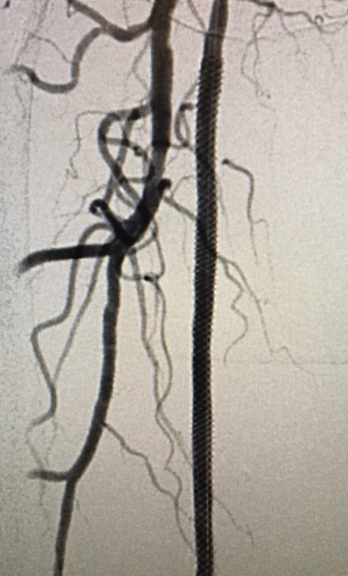
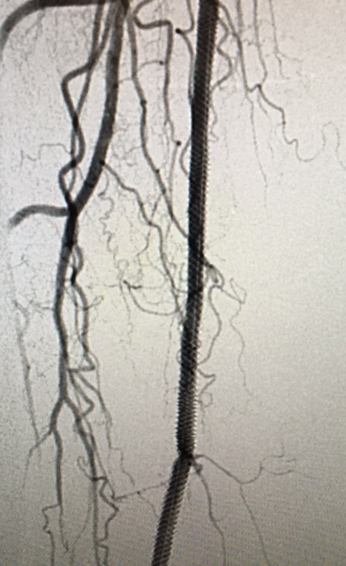
Successful stent – in this instance with 6.5 x 150 supera

Slide 21
Case 2
80 year old male with
Diabetes, CAD, Chronic renal insufficiency, s/p TAVR
Evaluated for worsening ulceration right foot and rest pain
MRI osteomyelitis
ABI – 0.3
Functional at home after TAVR
CT angiogram – Right popliteal occlusion – no reconstitution of infra popliteal vessels. Vascular surgery no options.
Has had no response to hyberbaric O2 therapy

Slide 22
TAVR done for functionality – do not want him non functional with Above Knee Amputation!!!!!!!!

Slide 23
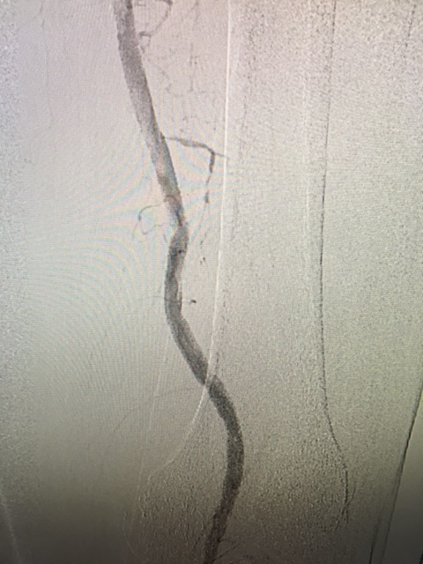
Patent Iliacs, CFA, SFA….

Slide 24
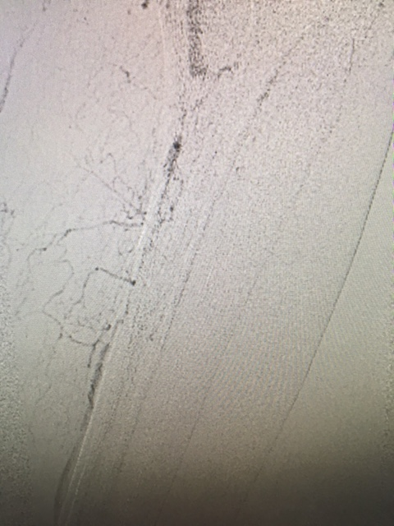
Occluded distal Pop, TPT, AT, PT and peroneal….

Slide 25
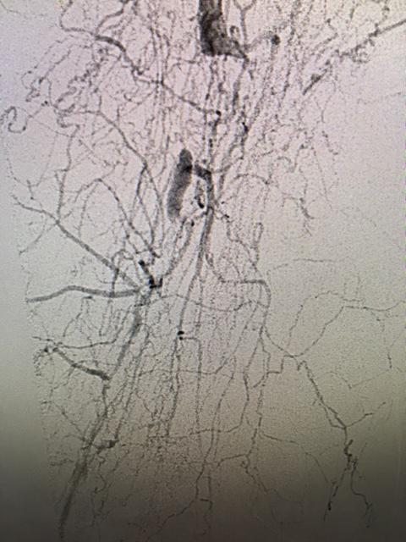
Super selective injection clearly demonstrated the anatomy

Slide 26
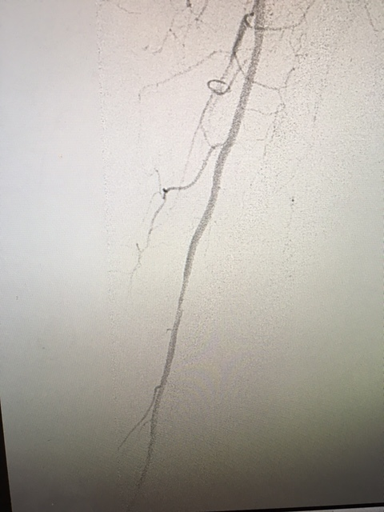
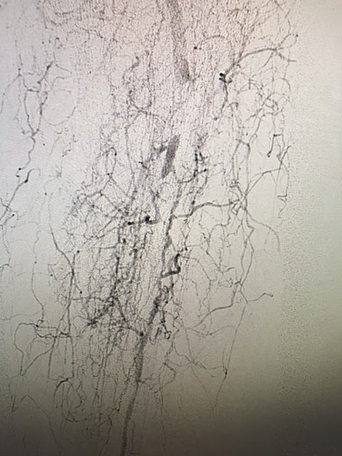
Reconstituted peroneal only run off – foot vessels not visualized

Slide 27
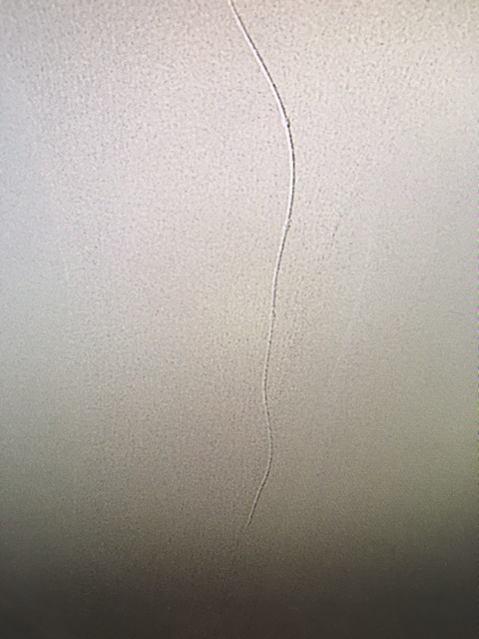
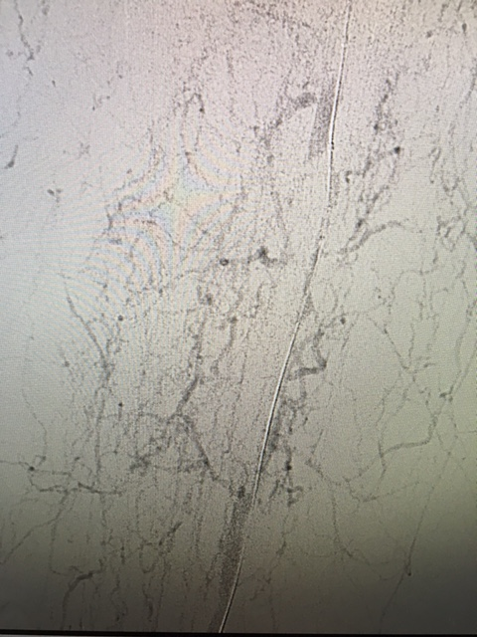
Proximal CAP is flat and calcified – Engaged with Astato 30 g tip wire and quick cross -Wire quickly sub intimal as it could not penetrate the proximal cap and was deflected to sub intimal space….

Slide 28
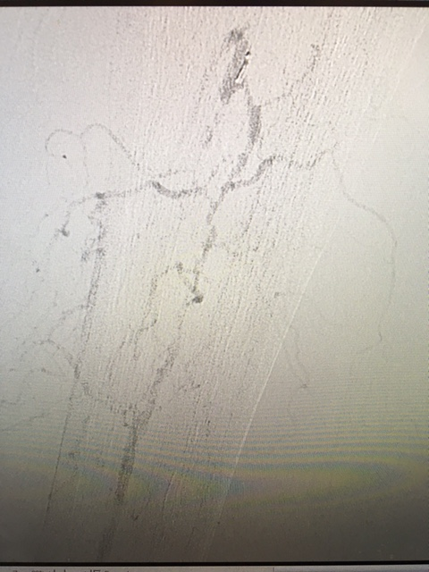
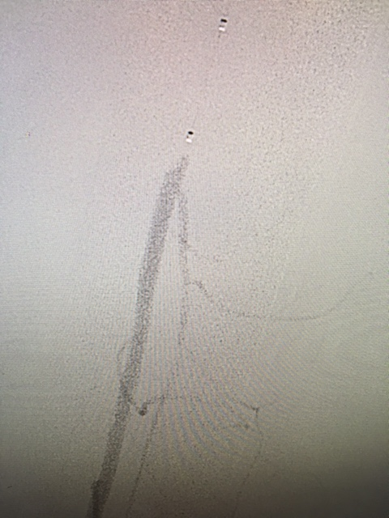
Popliteal CTO engaged with 0.0014 wingman – device intraluminal to TPT -Once in TPT – exchanged for a 0.0014 quick cross and pilot wire to navigate the tortuous diseased proximal peroneal and successful crossing….

Slide 29
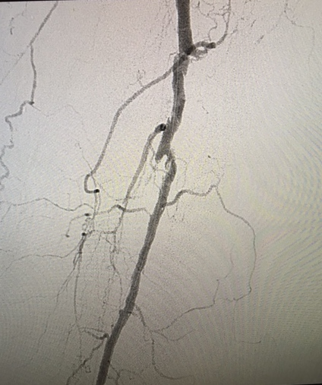
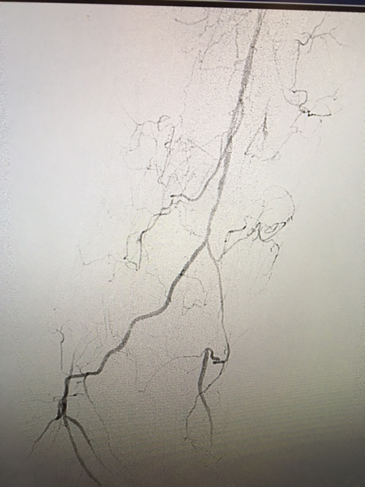
Post PTA –brisk peroneal runoff to foot collateralizing DP and PT

Slide 30
Wound clinic report – successful wound healing with just toe amputation

Slide 31
Conclusions
Challenges to long CTO recanalization remains and ideal strategy still remains to be defined
Defining CAP morphology and using the shape of the cap to make clinical decisions on access and approach although useful is not always predictable
These strategies are predicated on the fact that concave fibro-calcific caps are difficult to penetrate
Wingman device with its unique capability to penetrate tough proximal and distal cap regardless of the morphology, has the potential to eliminate some of the limitations of existing technologies in terms of cap penetration
Sometimes a simple and elegant device without any bells and whistles, that does not whirr or light up can get the job done
Lets Keep it SIMPLE!!!!

Slide 32
Case - 3
70 year old male with severe COPD
Known Severe PAD – s/p SFA stent 3 years ago
Admitted with rest pain, cellulits and ulceration right leg and foot
Venous Doppler Negative. H/o of right GSV ablation with no significant residual reflux
ABI 0.3
Foot red and weeping
Angiogram right SFA focal ISR 80% in 3 areas treated with laser Atherectomy and DCB in the first setting via contralateral access

Slide 33
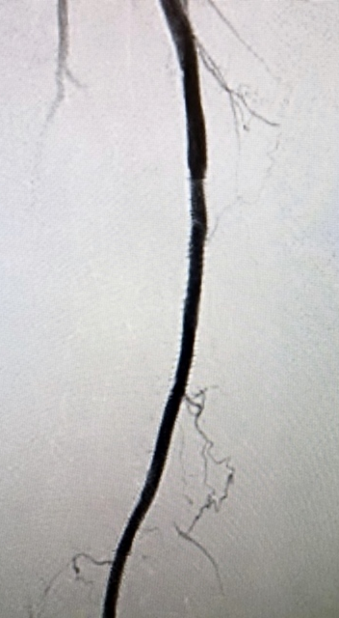
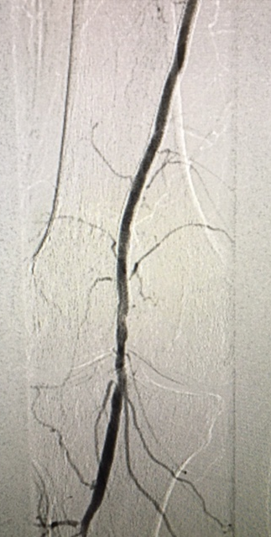
Patent SFA and Popliteal after laser Atherectomy and DCB of focal ISR

Slide 34
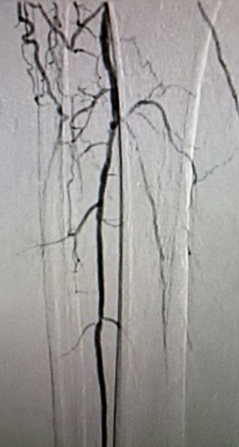
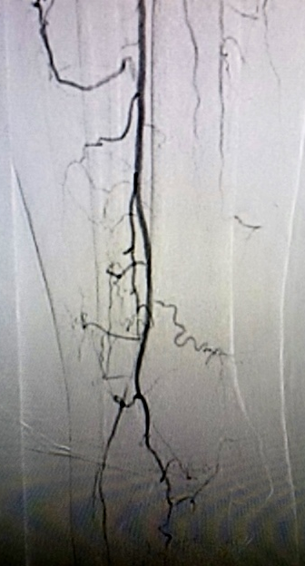
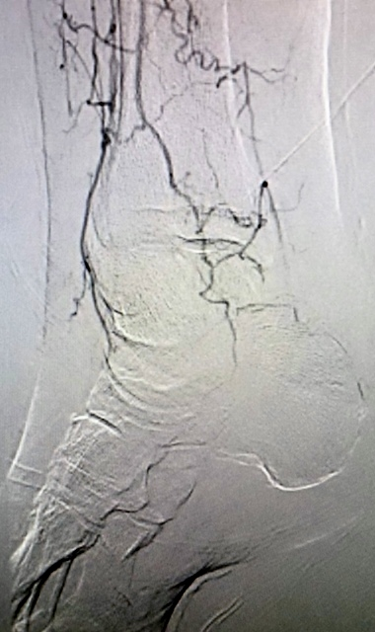
Super selective injection – patent peroneal and limited distal AT reconstitution

Slide 35
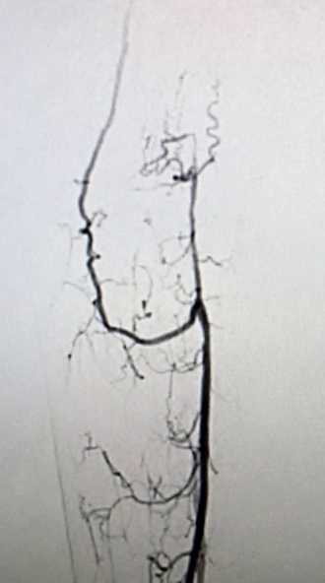
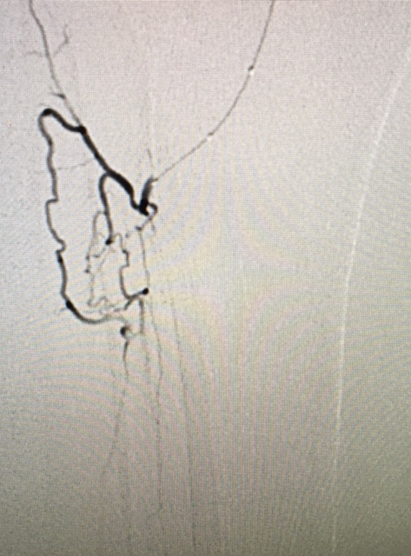
Antegrade CFA access and retrograde distal AT access

Slide 36
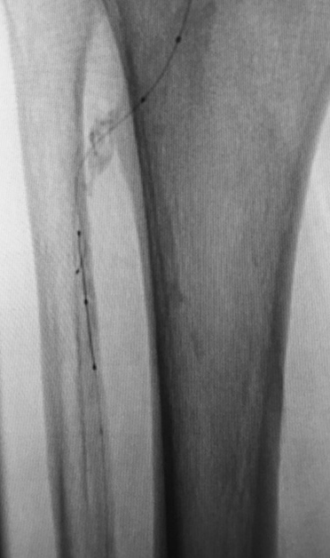
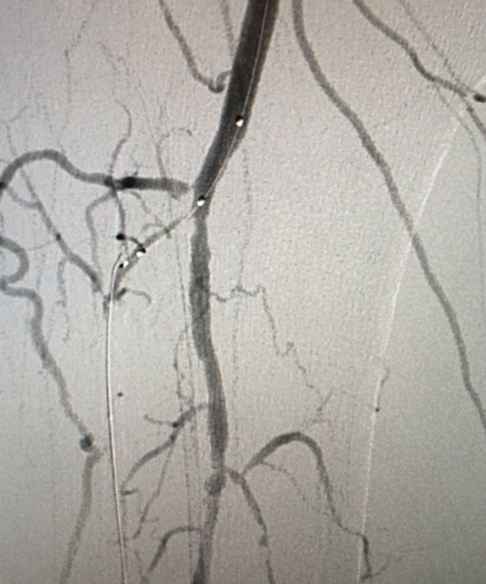
Unable to cross CTO proximal CAP with both antegrade and retrograde wires – Astato, Pilot 200, Terumo gold - Wires subintimal

Slide 37
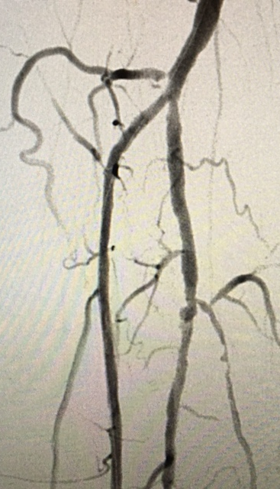
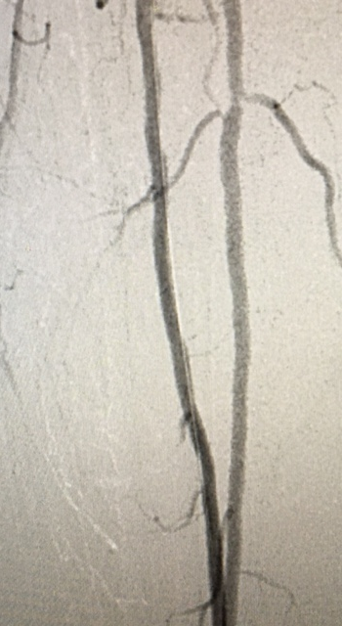
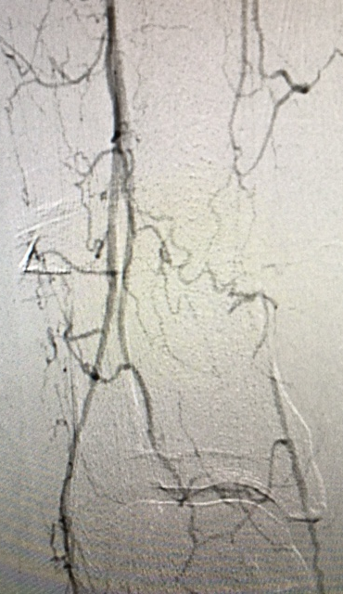
Successful penetration of the proximal CAP with 0.0014 wingman and successful crossing… followed by PTA and 2 vessel runoff

